Slide 1
Introduction to Patent Analytics
Manila
7 November 2017
Irene Kitsara
IP Information Officer, Access to Information and Knowledge Division

Slide 2
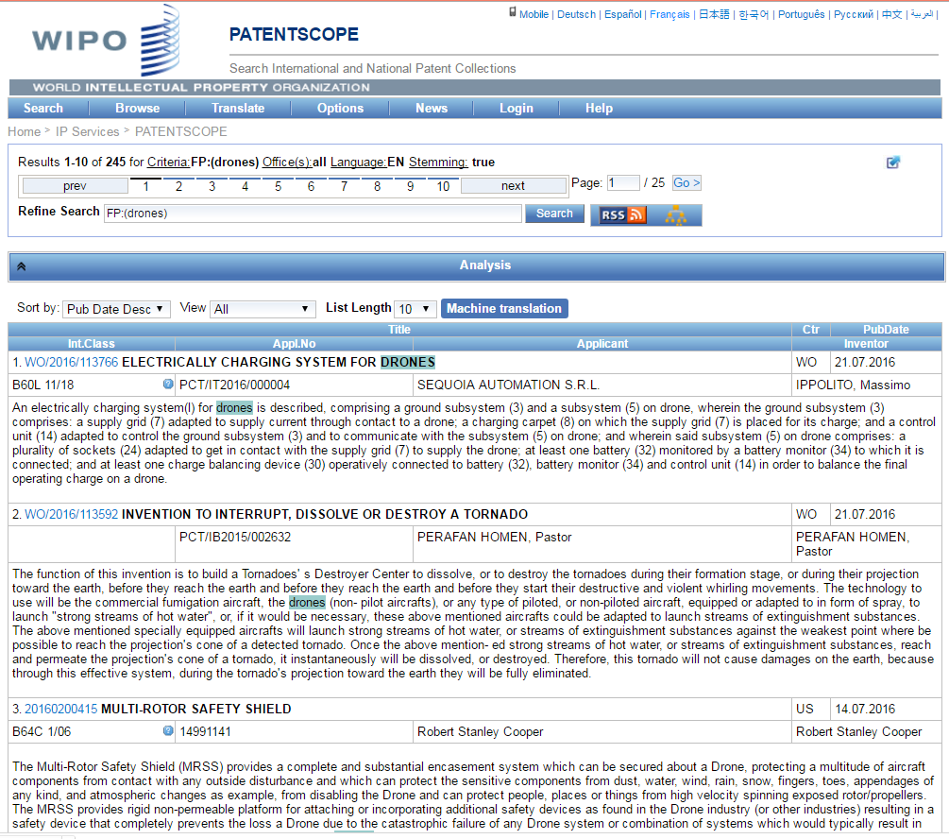
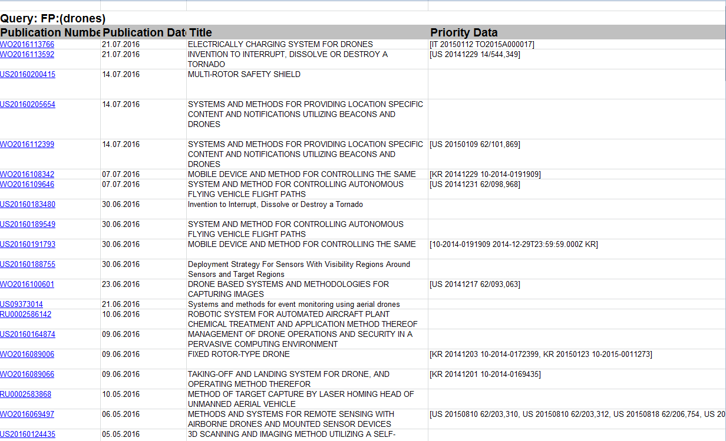
After the patent search results what?

Slide 3
What is patent analysis?
Structured and meaningful presentation of patent data with the help of tools, visualizations and narrative as a decision-making support mechanism
Raw Data
Patent Search
Patent Analysis

Slide 4
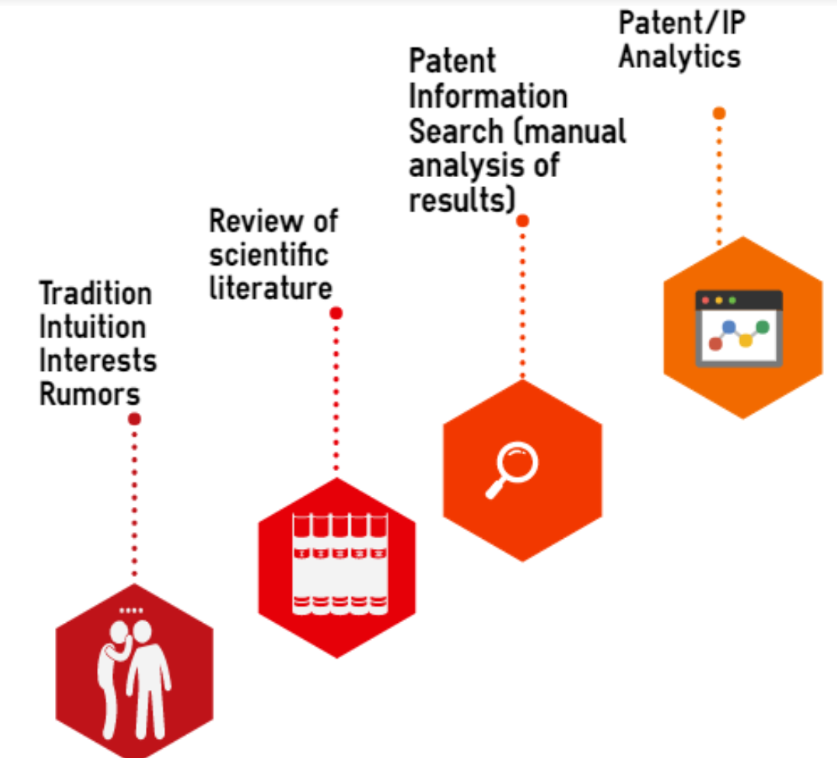
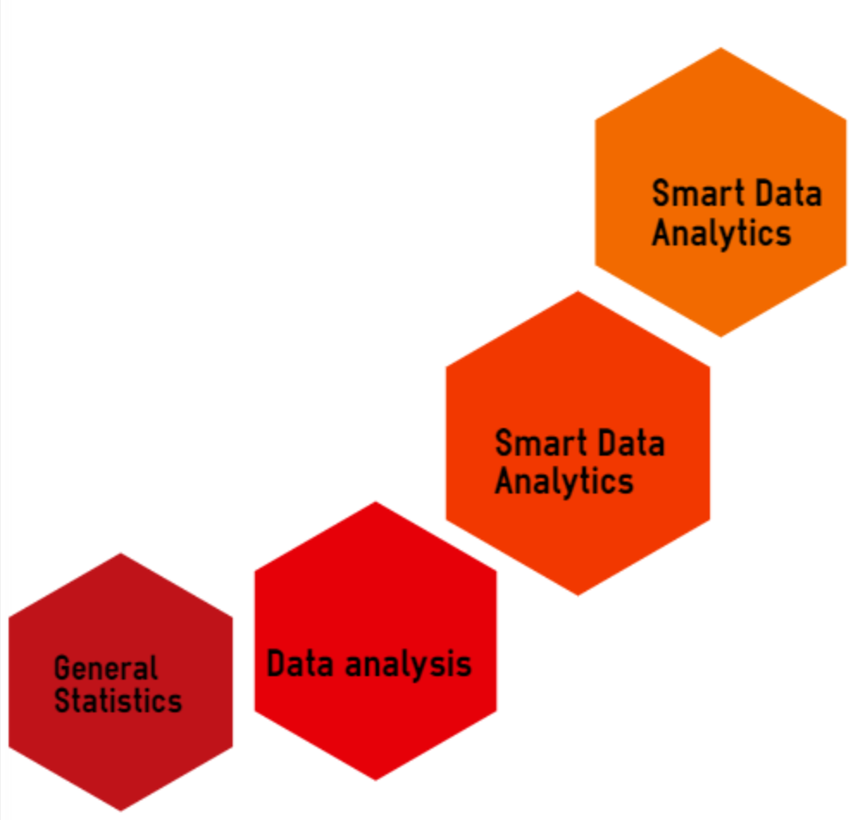
Evolution of analytics to support decision-making and IP management

Slide 5
Important considerations to define objectives of a successful patent analysis
Who is the analysis intended for? – Needs assessment
How will this analysis have added value to the report recipient and his/her decision making process? – Effective support tool for decision making
How will the analysis save time to the recipient? Efficiency of the report and appropriateness of information and presentation of it

Slide 6
How are decisions taken and how does patent information help?
Cross sectoral/disciplinary effort: many aspects taken into account (Science/Policy/Economics/Business/Marketing)
Policy/prioritization issues
Relevant market definition and analysis
Competitors activity and analysis
Economic/financial aspect
Risk
Patent Information: important source of information
Technical
Business data
Legal

Slide 7
What can be the objective of a patent analysis?
Policy discussions/decisions
R&D decision-making and prioritization
Investment and collaboration decisions
Technology transfer
Competitors monitoring
Technology scouting and whitespaces/business opportunities
Patent valuation
Patent portfolio assessment

Slide 8
What is the added value of patent analysis?
Presents patent data, search results and findings in a structured way
Creates an output that makes technical data easily understood by non-experts
Includes visualization of the results making the information easily and fast to digest
Facilitates interdisciplinary dialogue between various stakeholders

Slide 9
Different types of patent analysis and similar products
Patent Landscape Reports
Portfolio analysis
Business/Competitive intelligence report
Freedom to Operate Analysis
Technology Watch/Alerts
Technology Bulletins
General Statistics

Slide 10
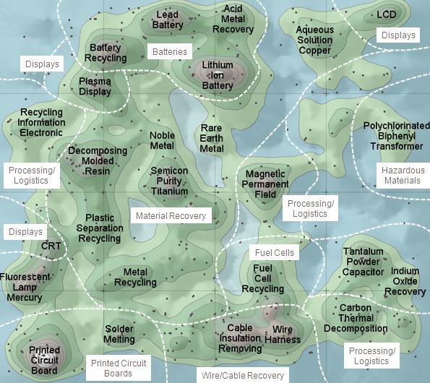
What is a Patent Landscape Report (PLR)?
Different terms used e.g.:
Patent Mapping, Patent Cartography
Business Intelligence, Competitive Intelligence
Various definition approaches:
from very narrow
(just a graphical representation)
to very broad
(including Freedom to Operate elements)
« Patent map »(Themescape)
Source: WIPO PLR on Electronic Waste Recycling

Slide 11
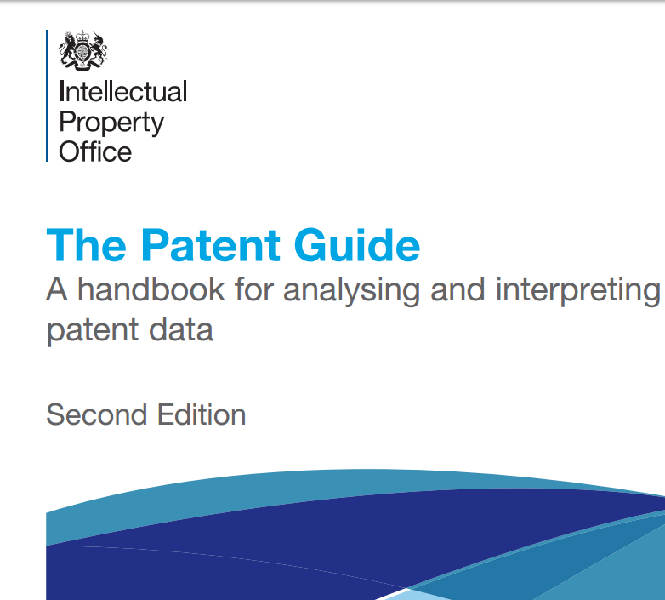
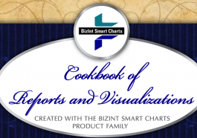

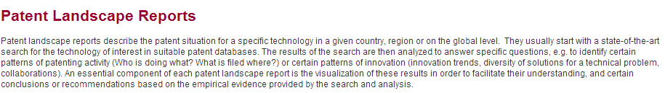


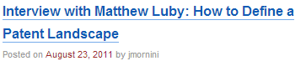
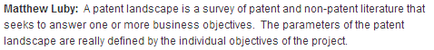


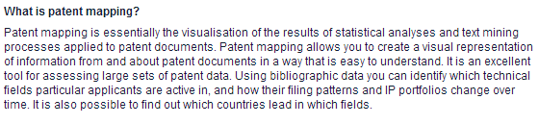
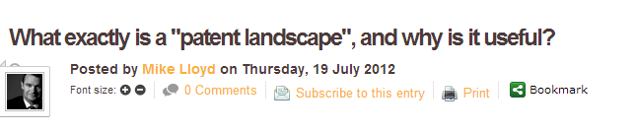
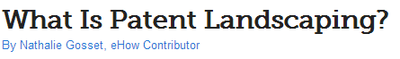
PLR Terminology and Methodology

Slide 12
What is a Patent Landscape Report (PLR)?
Research and analysis of innovation patterns and patenting trends in a specific technological field/geographical area using patent information
Content and analysis types customized to the concrete needs
It can have a very narrow to a very broad scope and serve various needs, e.g. WIPO PLR on atazanavir and the PLR on animal genetic resources
Geographical coverage can vary and can have or include country focus (e.g. BRIC countries)
It typically does not include legal status information, yet in some cases such data forms part of the report

Slide 13

What kind of questions can a PLR answer?
(The Answer to The Ultimate Question of Life, the Universe, and Everything, The Hitchhiker's Guide to the Galaxy, Douglas Adams)
Which technology trends exist in which geographical areas and how have they developed over time?
Are there gaps or white spaces, i.e. areas with little patent protection, that permit business opportunities or give them an added value?
Which players are the most active in a said technical area and what is their specific focus and strategy?
Which other patents are relevant for a company’s activities or a product development/commercialization? (Infringement/FTO, licensing-in, collaborations)
Which patents are about to expire ? Which technologies move in the public domain and provide business opportunities ?
What is the patent portfolio of competitors and what is the impact on the company’s portfolio and activities? Correlation and effect on value

Slide 14
What kind of analysis can be included in a Patent Landscape Report?

Slide 15
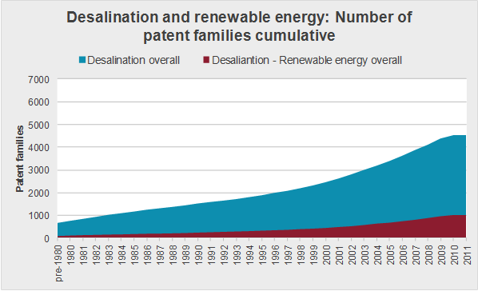
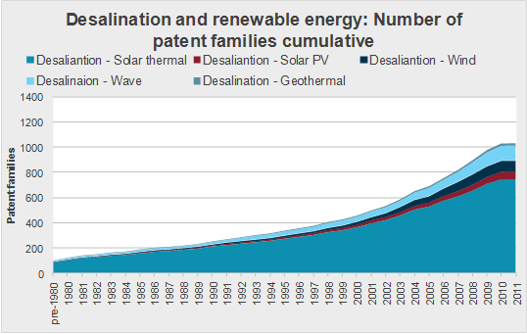
General trends vs. trends in subsectors
Source: WIPO PLR on Water desalination and the use of renewable energies
Help identify promising, emerging or saturated technology areas
Identification of potential niche technologies

Slide 16
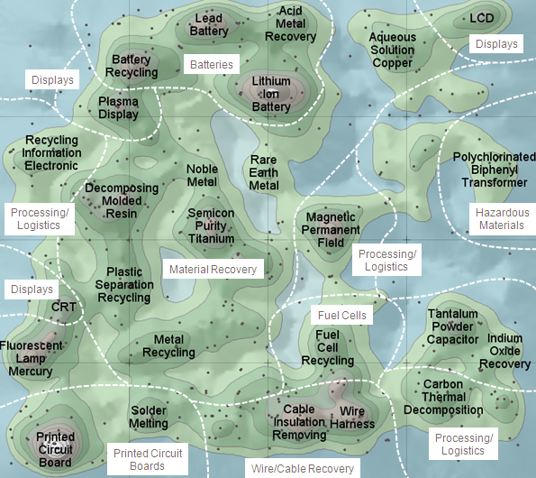
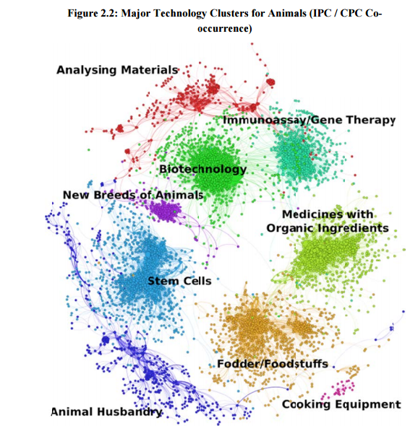
Clustering of prominent technology areas
Network mapping in Animal Genetic Resources PLR
Thematic Concept (Themescape) of E-Waste Landscape

Slide 17
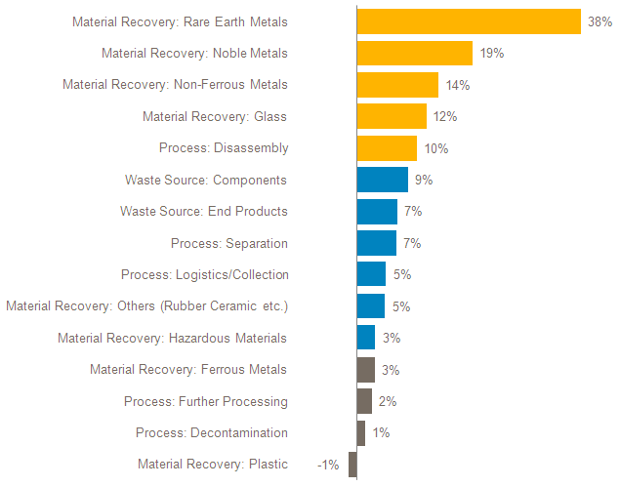
Annual Growth rate in patent filing areas
Patenting Activity Trends in E-waste by Subject Matter; Annual Growth/Decline 2006-2010 (based on Earliest Year of First Filing)

Slide 18
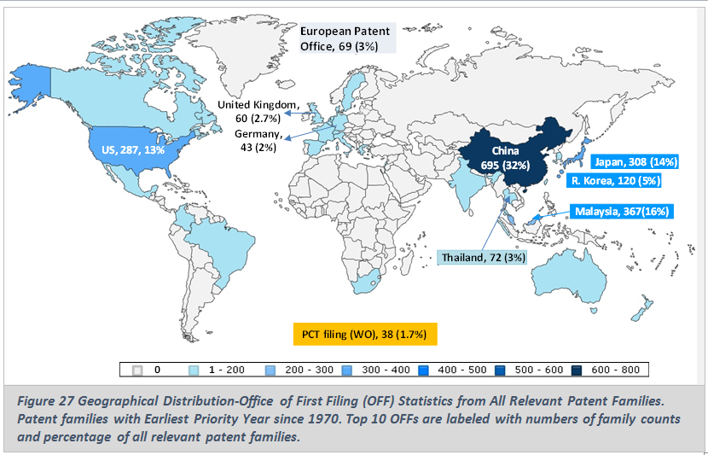
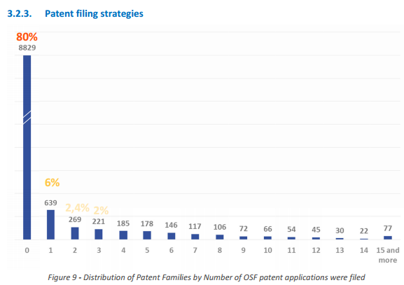
Geographical distribution of patent protection
General trends (OFF)
Patent filing strategies (OSF)
Source: WIPO PLR on Palm Oil
Source: WIPO PLR on Microalgae

Slide 19
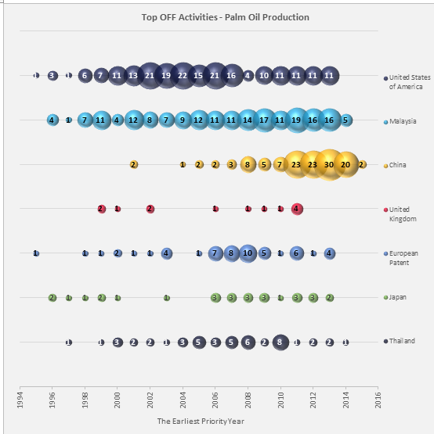
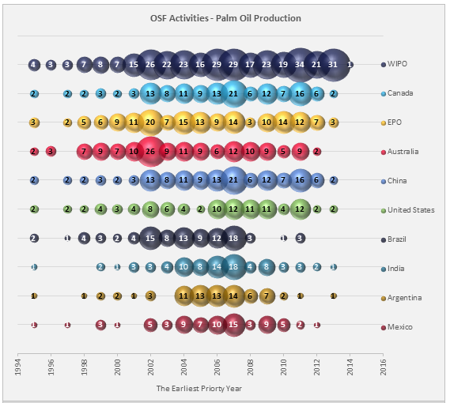
OFF and OSF as indicators of innovation and potential market
Top OFF – Filings over time
Top OSF – Indirect market analysis

Slide 20
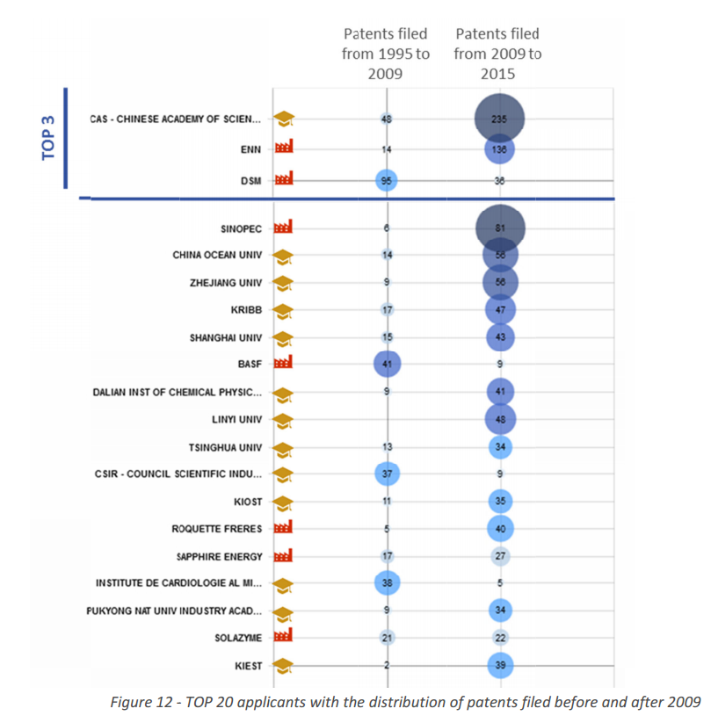
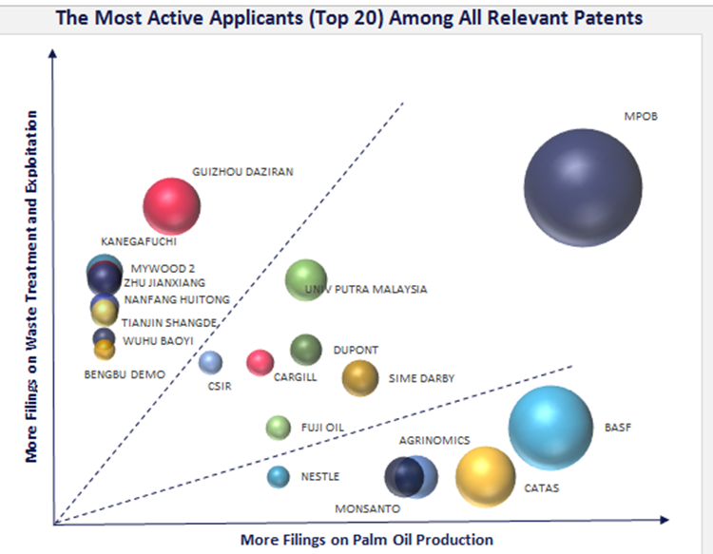
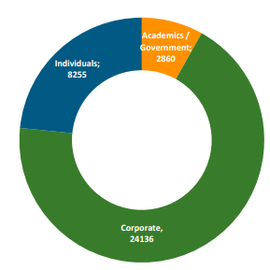
Major players in a field, profile, new players, change in focus and strategy
Key players, profile, recent activity
Key players focus areas
WIPO PLR on Palm Oil
WIPO PLR on Microalgae
WIPO PLR on Assistive Devices for Visually and Hearing Impaired Persons

Slide 21
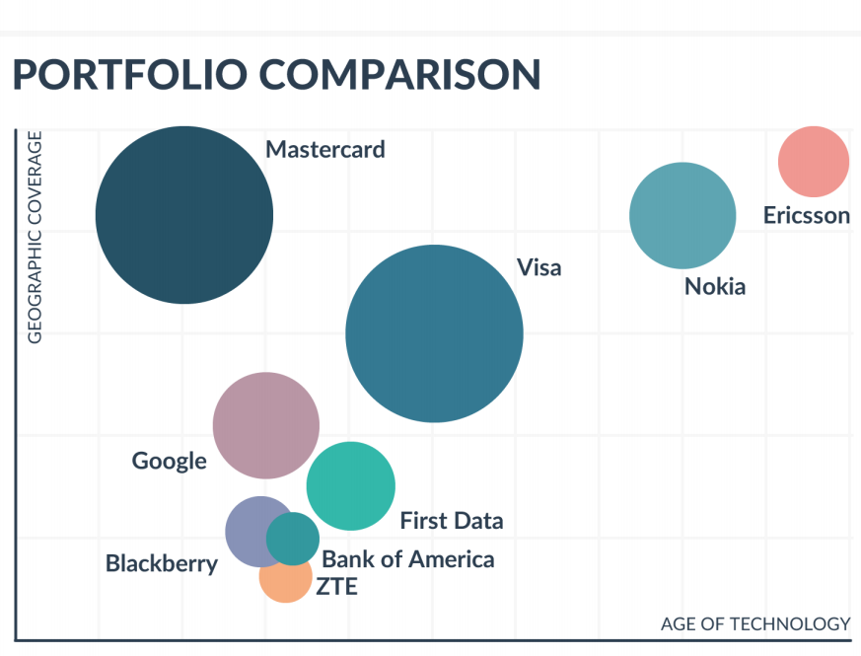
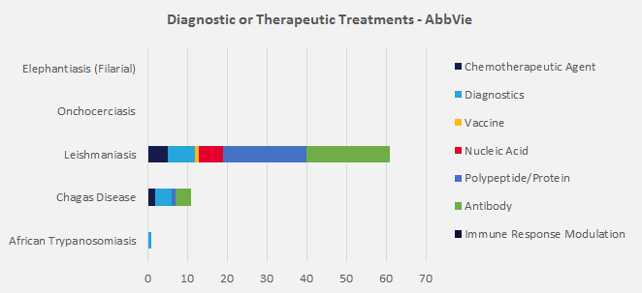
Specific applicants analysis
Applicant focus and portfolio
Geographical coverage and age of technology
WIPO Selected Neglected Diseases PLR

Slide 22
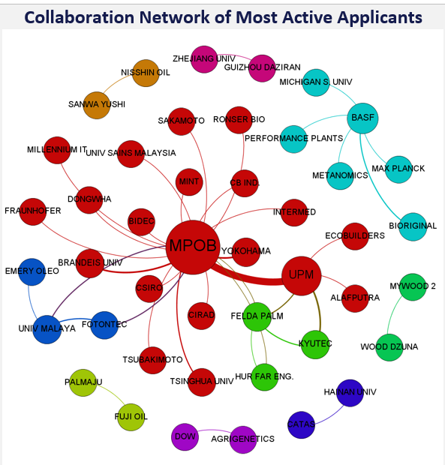
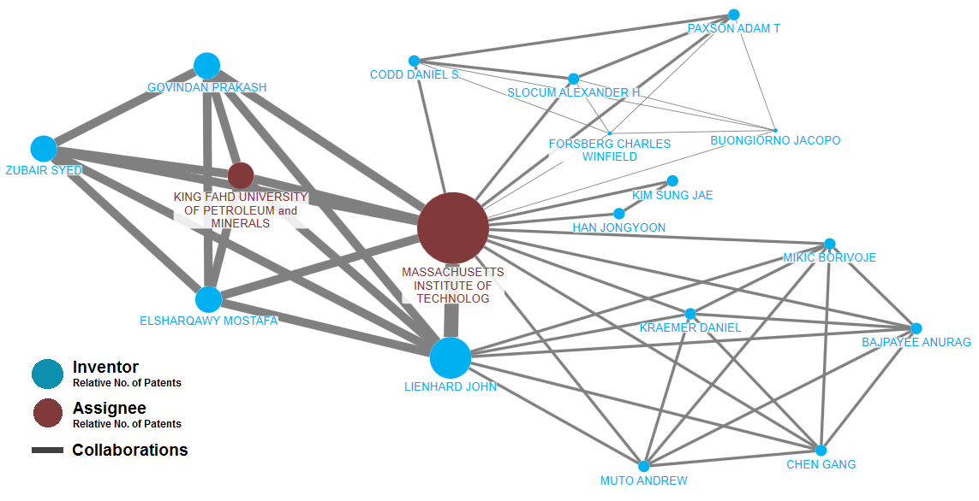
Co-assignments and collaboration networks
Co-assignments – applicants collaboration networks
Applicant-inventors collaboration network
WIPO Palm Oil Production PLR
WIPO Desalination PLR

Slide 23

Matching patents to products
Source: WIPO PLR on Solar Cooking

Slide 24
Combining patent with non-patent data
Source: IEA, Energy Technology R&D Statistics 2007
R&D in- and output, patenting activity as indicator of innovation

Slide 25
Patent Landscape Reports in a nutshell
Patent based analysis tailored to specific needs
IP management and internal/external valuation support tool:
more focused approach and informed decisions
avoidance of duplication of work, waste of resources and infringement of 3rd party IP rights
Who is doing what (e.g. top applicants, inventors) where?
Market trends and potential, uniqueness and value of own IP assets and market position, tech transfer possibilities
identification of own potential and position in a given or emerging market and comparison to competitors
facilitation of local and international cooperation and identification of potential for synergies
Additional, non patent-data completing the puzzle, e.g. econometric /competitor analysis, case studies, licensing information, M&As etc.

Slide 26
Other patent analysis types

Slide 27
Freedom to Operate Analysis/Clearance
Resembles a Patent Landscape Report – terms often confused
Sophisticated and costly analysis, usually performed before a new product is introduced in the market
Objective: make sure there are no third party IP rights infringement when a product is launched in the market
Key differences to a PLR:
Type of conducted patent search-granularity of search and claim analysis of granted patents
Country-market specific
Legal status information
There is never a 100% - real “FTO”

Slide 28
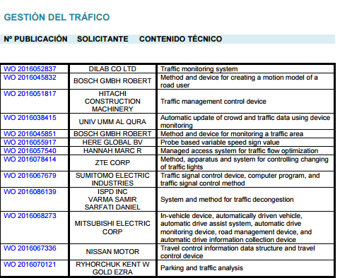
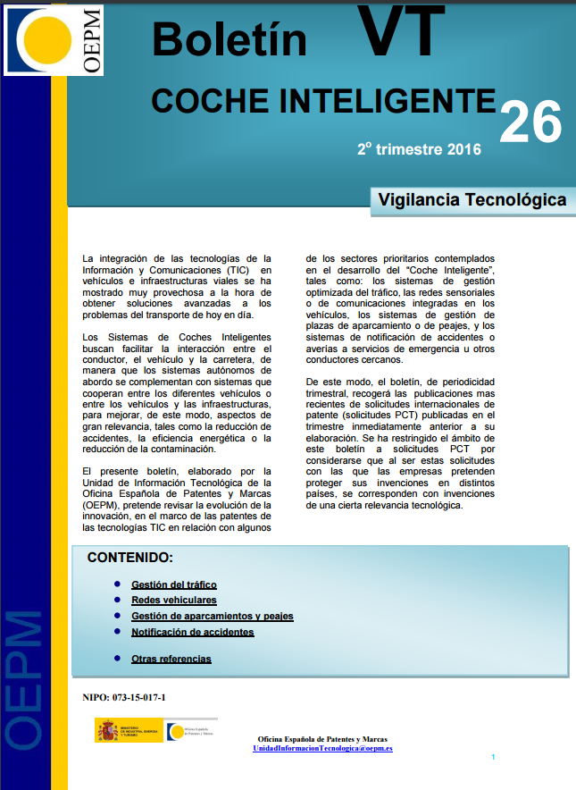
Technology Bulletins
Example: Spanish Patent Office: Intelligent Car
What does it include?
http://www.oepm.es/export/sites/oepm/comun/documentos_relacionados/Boletines

Slide 29

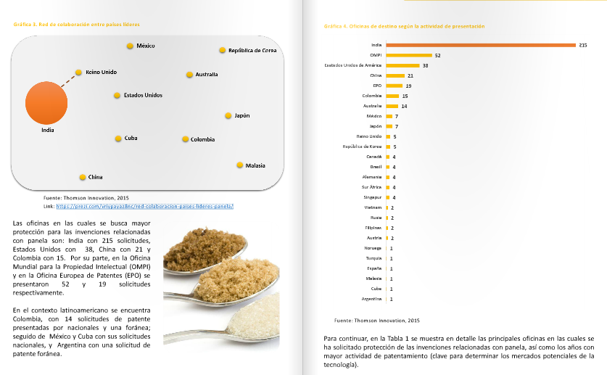
Technology Bulletins can also look different though…
Colombian CIGEPI
How do the Colombian Bulletins look like?

Slide 30
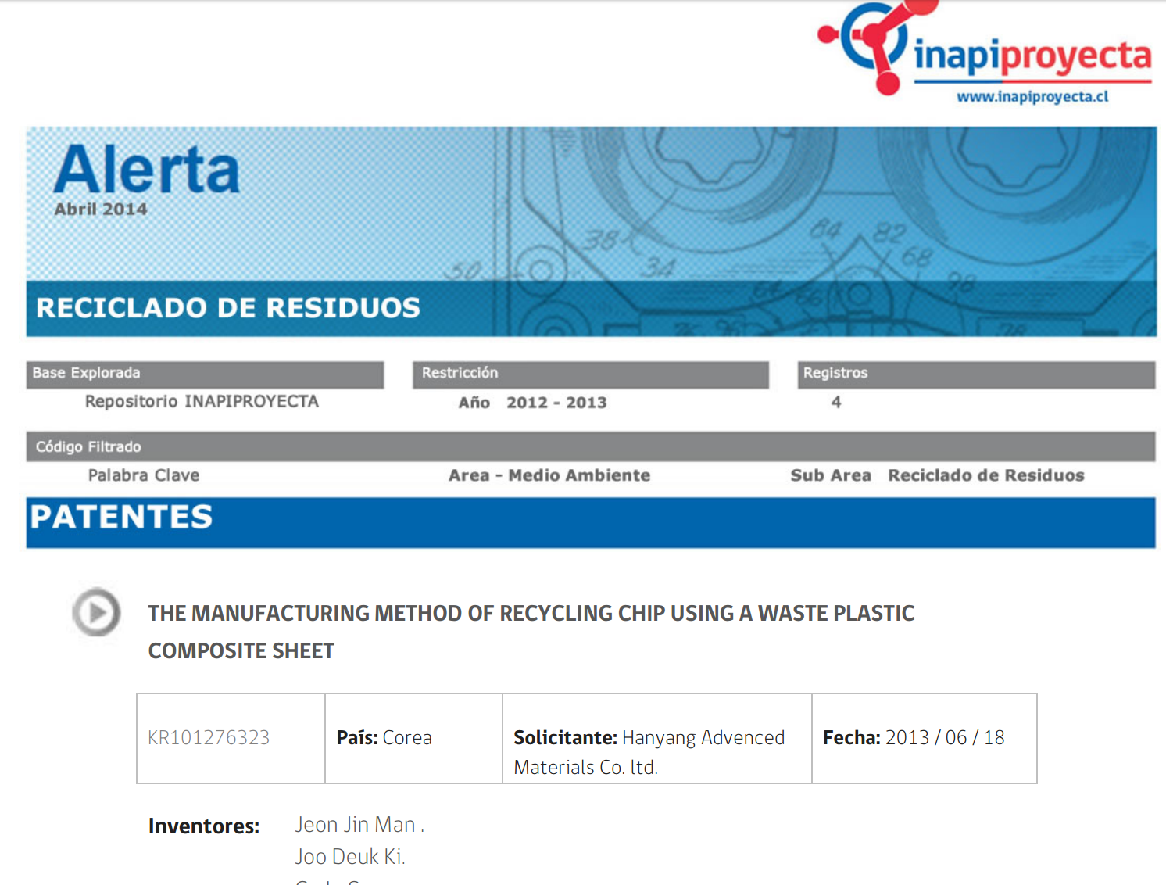
Technology Watch/Alerts/Surveillance/Monitoring
Updates/information on new patents in a given area of interest
Usually limited to a list of patents and their bibliographic data/representative drawing or link to the full document

Slide 31

General Statistics

Slide 32

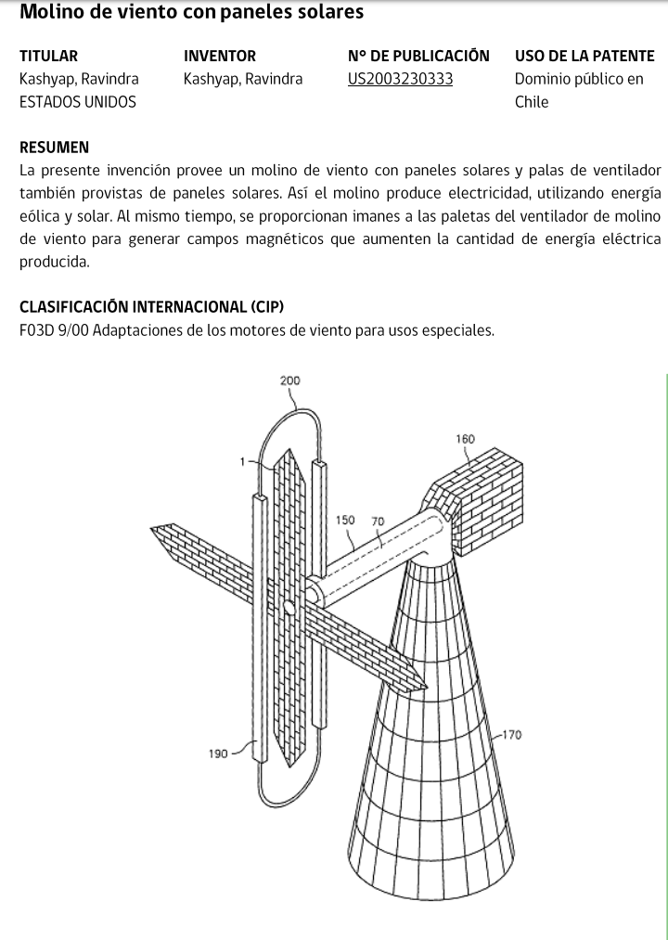
Reports on patents in the public domain

Slide 33
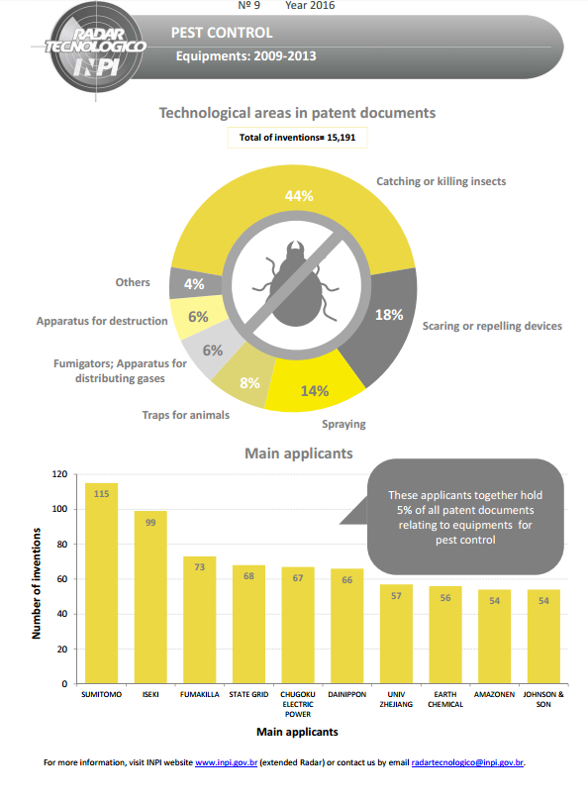
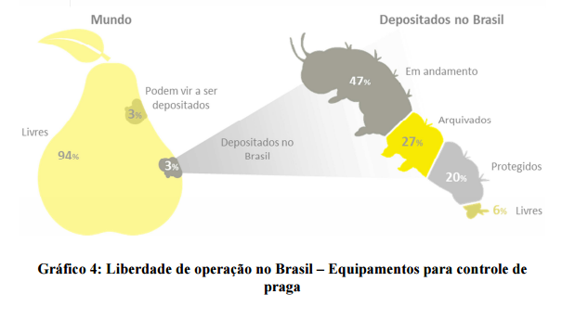
Mixed analysis types
FTO element
“Technology Radar” (INPI Brazil) – Infographic Element

Slide 34
Portfolio/competitors analysis/Business/Competitive Intelligence
Typical private sector analysis types
Part of “business intelligence”: costly, added-value information /“competitive intelligence” not available in public websites
Includes elements like analysis of competitors, analysis of own portfolio, litigation cases, patent valuation, market analysis, licensing agreement, social media/blogs and news analysis, patent strength etc, risk assessment, M&As etc.

Slide 35
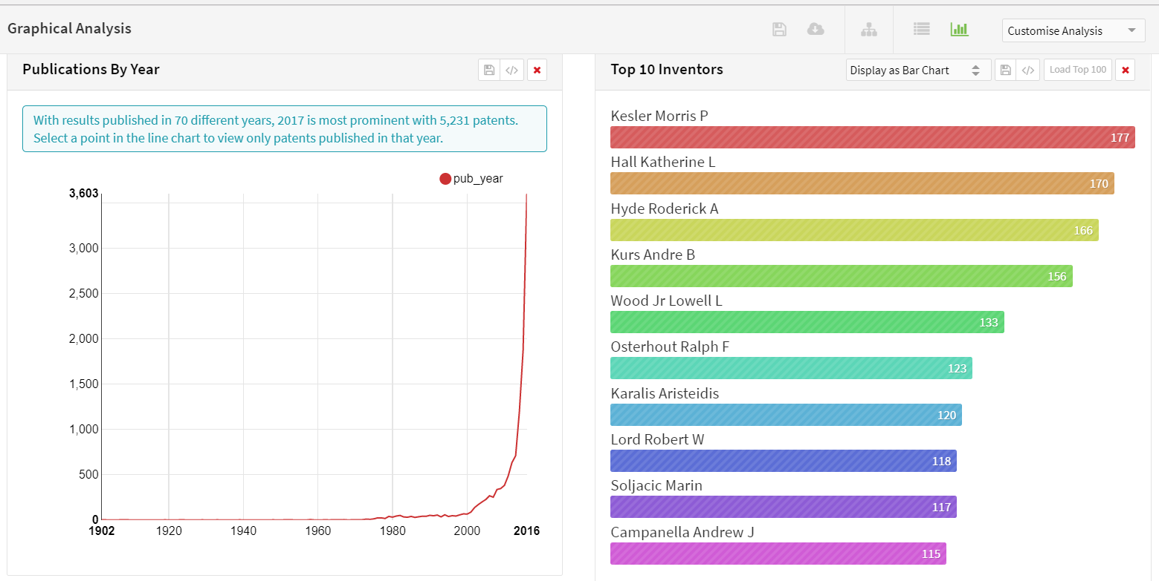
Interactive analytics / Dashboards
The user selects his analysis criteria/filters
e.g. the Lens

Slide 36
Conclusions
Different types of patent analysis serving different needs
No consistent terminology – many overlaps and some misconceptions
A good patent analysis can support decisions, yet not a panacea

Slide 37
What are the risks of patent analysis?
Insufficient data leading to wrong results – importance of good data and adequate databases
Wrong results and assumptions – importance of a good methodology
Irrelevant data and analysis to the important questions/decisions to be taken – importance of good and relevant questions, and choice of data to analyze
Poor or misleading visualizations – the importance of adequate and meaningful visualizations
Lost in data! Not clearly communicated findings and messages – importance of good communication skills
Data as such have no value if not contextualized and interpreted correctly – the importance of a good patent analyst

Slide 38
Thank you!
Irene.Kitsara@wipo.int

